Slide 1
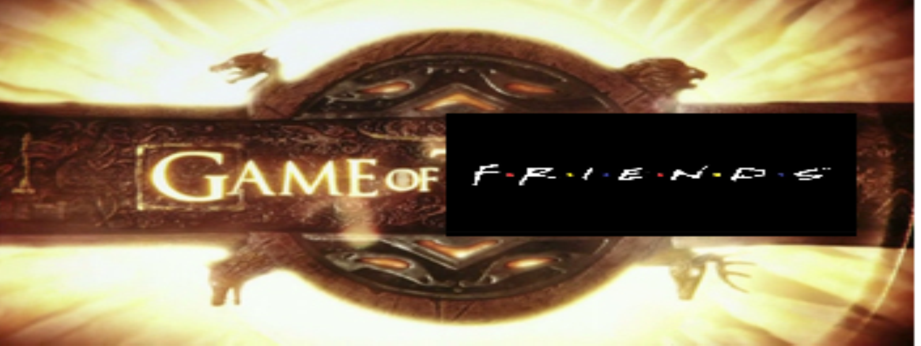



A Game of Friends
Justin Sanny| B.J. Johnson | Loyola Marymount University
Project Description
Justification
A Game of Friends is a 2-player game, developed for Android devices. It has players answers a series of humorous questions. These questions are made to create a comfortable environment where each player can learn more about the other.
Learn to develop for Android applications
Gain experience with creating and following a self-made development schedule
Create an app-inspired version of the “Newly Wed” Game.
Functionality
Answer questions to figure out intimacy of relationship
Play with friends and family for amusement
Receive score based on matching answers
Technologies
Future Plans
Add a database for questions
Add IOS functionality
Create a web-based game
Host on a server
Copyright
I do not reserve the rights to Game of Thrones, Friends, or any other affiliate company/product.

